Slide 1
Leveraging Stereopsis for Saliency Analysis, CVPR 2012
Speaker: Chi-Yu Hsu
Advisor: Prof. Jian-Jung Ding

Slide 2
Outline
Abstract
Introduction
Stereo Saliency
Experiments
Conclusion

Slide 3
Abstract

Slide 4
Introduction
Stereopsis provides an additional depth cue and plays an important role in the human vision system.
Two approaches:
- computes stereo saliency based on the global disparity contrast in the input image.
- leverages domain knowledge in stereoscopic photography.
Build a stereo saliency analysis benchmark dataset that contains 1000 stereoscopic images with salient object masks.

Slide 5
Stereopsis
Stereopsis is a process in visual perception leading to the perception of depth from retinal disparities.
Created by projecting two slightly different images onto the retinas of the two eyes.
Stereoscopic depth often enables people to identify objects from the background with similar visual attributes.

Slide 6
Stereo Saliency
Compute stereo saliency from the disparity map between the left and right view of a stereoscopic image.
Low-level disparity contrast
Unique domain knowledge

Slide 7
Disparity Map
Estimates a disparity map from the left and right view of a stereoscopic image.
Dense disparity map is obtained from stereo matching.
Apply the SIFT flow method to disparity estimation for its robustness.

Slide 8
Example

Slide 9
Stereo Saliency from Disparity Contrast
When taking a photo, people tend to place an important object at a different depth level than the others.
Extend a recent color contrast-based saliency detection method from Cheng et al (RC).
Consider both color and disparity during segmentation by treating the disparity value as a fourth channel.

Slide 10
Stereo Saliency from Disparity Contrast
The saliency value for each region is computed based on its contrast with all the others in the image.
Sc(Ri): the saliency for region Ri.
d(Ri,Rk): the disparity difference between Ri and Rk.
(the average disparity difference between each pixel in Ri and Rk.)
nk: the size of Rk.

Slide 11
Stereo Saliency from Disparity Contrast
Considering the abruptness of disparity change in computing the disparity difference.
dv(p, q): the disparity difference between pixel p and q, defined as|dq−dp|.
dm(p, q): the maximal disparity change along the path between p and q.
w(p, q): a weight computed according to the spatial distance between p and q.$w\left(p,q\right)=e^{−{\left\|p−q\right\|}^{2}/σ^{2}}$

Slide 12
Stereo Saliency from Disparity Contrast

Slide 13
Domain Knowledge Assisted Saliency Analysis
A zone close to the screen is called the comfort zone.
In practice, content of interest is often given small or zero disparities to minimize the vergence-accommodation conflict.
Two rules to compute knowledge-based stereo saliency.
1. Objects with small disparity magnitudes (e.g. in the comfort zone) tend to be salient.
2. Objects popping out from the screen tend to be salient.

Slide 14
Stereoscopic Comfort Zone

Slide 15
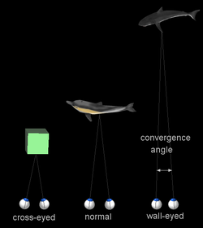
Vergence
A vergence is the simultaneous movement of both eyes in opposite directions to obtain or maintain single binocular vision.
The two eyes converge to point to the same object.

Slide 16
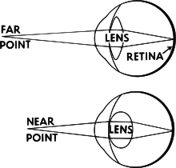
Accommodation
Accommodation (Acc) is the process by which the vertebrate eye changes optical power to maintain a clear image (focus) on an object as its distance varies.

Slide 17
Rule 1
Objects with small disparity magnitudes (e.g. in the comfort zone) tend to be salient.
dmax: the maximal disparity.
dmin: the minimal disparity.
di: the average disparity in region Ri.

Slide 18
Rule 2
Objects popping out from the screen tend to be salient.
Objects with negative disparities are perceived popping out from the screen. This suggests that the more negative an object’s disparity is, the more it is perceived popping out.

Slide 19
Rule 1 and Rule 2

Slide 20
How to combine R1 and R2
When an image only has negative disparities, the whole scene is perceived popping out from the screen.
When an image has both negative and positive disparities, it is more likely that the disparity distribution of this image has been adjusted either manually or automatically by the camera to minimize the vergence-accommodation conflict.
: the number of pixels with a negative disparity and n is the total number of pixels in the image.
γ: a parameter with default value 0.5.

Slide 21
A common problem
Some background regions will be detected as salient.
Disparities change little in each row in background.
Compute the local disparity contrast along each row.
p: a pixel in region Ri.
dp: its disparity
:the average disparity of the row that contains p.

Slide 22
Local contrast-based saliency analysis

Slide 23
The Final Stereo Saliency Map
Multiplies the global disparity contrast-based saliency Sc with the domain knowledge-based saliency Sr as the final stereo saliency.

Slide 24
Experiments Database
There is no publicly available stereoscopic image database for saliency analysis.
1250 stereoscopic images from Flickr, Stereoscopic Image Gallery, and NVIDIA 3D Vision Live.
Three users are asked to enclose the most salient object in each image with a rectangle.
Remove the images with the least consistent labels.
Ask a user to manually segment the salient object.
1000 stereoscopic images with human-labeled mask.

Slide 25
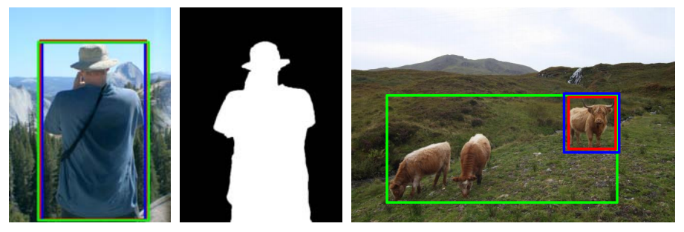
Benchmark Examples
The first image was consistently labeled by three users and was included into our dataset.
Its salient object mask is shown in the middle.
The last image was not consistently labeled and was removed from our dataset.

Slide 26
Performance Evaluation
Evaluate the three saliency maps from our methods, namely global disparity contrast-based stereo saliency (CSS), knowledge-assisted stereo saliency (KSS), and their combination (SS).
Selected six state-of-the-art saliency detection methods, including RC, CA GB, FT, SR, and MS.

Slide 27
Visual Examples

Slide 28
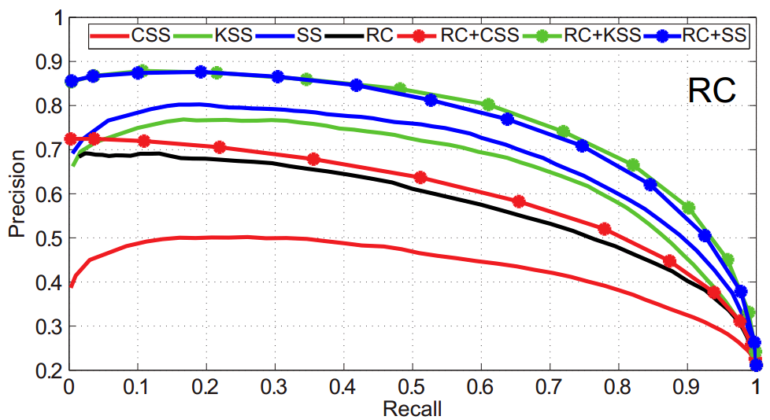
Precision and Recall

Slide 29
Automatic Salient Object Segmentation
Initializes the segmentation with a binarized saliency map.
The threshold which gives 95% recall rate in the previous experiment
The Grab-Cut method is extended to take the binarized saliency map as input and is iteratively applied to segmentation.
Use both color and disparity to compute the difference between two pixels in the Grab-Cut framework.

Slide 30
Precision and Recall

Slide 31
Visual Examples

Slide 32
Limitations
Performance of the methods depend on the quality of disparity maps.
Stereo saliency is useful only if a salient object stays at a different depth than its surroundings. This is the same as saliency analysis w.r.t other visual features.
If an object cannot be separated from the background w.r.t one feature, the saliency analysis based on that feature fails.

Slide 33
Conclusion
Two methods for stereo saliency detection.
The first method computes stereo saliency based on global disparity contrast.
The second method makes use of the stereoscopic rules for saliency estimation.
Experiments showed that stereo saliency is a useful complement to existing visual saliency analysis and the methods are able to achieve high-quality stereo saliency detection results.

Slide 34
Q&A

Slide 35
Reference
Yuzhen Niu, Yujie Geng, Xueqing Li, and Feng Liu. Leveraging Stereopsis for Saliency Analysis. IEEE CVPR 2012.

